Slide 1
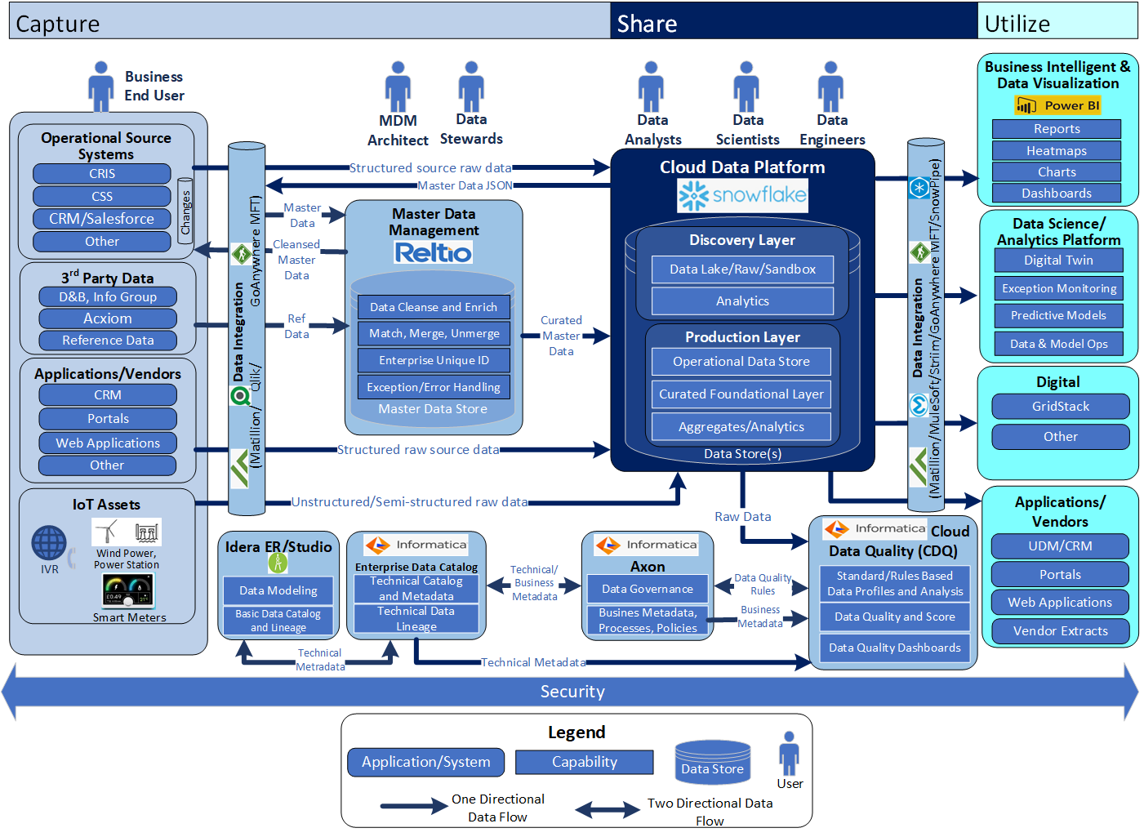
US Customer Platform End Architecture
Notes:
Bottom-up view of enabling Data Capabilities in support of prioritized business capabilities
- Iterative approach to building out capabilities incrementally though data enablement – Clean data available and under management - Master Data managed under MDM and both Master and Transaction Data Available within the Data Hub
Business Capabilities sequencing and timelines are still subject to Top-Down Analysis under the Program Governance & Alignment and Technology Solutioning Towers (taking place over the next 3-4 months, but subject to funding)
- Programs need to re-align priorities and release plan, cross-program gaps and dependencies need to be revisited and programs must be funded and resourced accordingly. This is especially impacted by program gaps in CRM and Automated
Marketing capabilities
- Note: CRM and Marketing Automation Completes in Dec 2022
Timelines for many of the required business capabilities extend beyond May-2022 which are being driving by process and tech changes
Some Capabilities that the Blueprint suggests will be dependent on a step change in platform can begin to be enabled by a Step change in data (e.g. Billing Insights). Other such as (New Service Connect) will obviously be clearly be dependent on AMI service

Slide 2
US Customer Platform MVP2 Architecture
Notes:
Bottom-up view of enabling Data Capabilities in support of prioritized business capabilities
- Iterative approach to building out capabilities incrementally though data enablement – Clean data available and under management - Master Data managed under MDM and both Master and Transaction Data Available within the Data Hub
Business Capabilities sequencing and timelines are still subject to Top-Down Analysis under the Program Governance & Alignment and Technology Solutioning Towers (taking place over the next 3-4 months, but subject to funding)
- Programs need to re-align priorities and release plan, cross-program gaps and dependencies need to be revisited and programs must be funded and resourced accordingly. This is especially impacted by program gaps in CRM and Automated
Marketing capabilities
- Note: CRM and Marketing Automation Completes in Dec 2022
Timelines for many of the required business capabilities extend beyond May-2022 which are being driving by process and tech changes
Some Capabilities that the Blueprint suggests will be dependent on a step change in platform can begin to be enabled by a Step change in data (e.g. Billing Insights). Other such as (New Service Connect) will obviously be clearly be dependent on AMI service

Slide 3
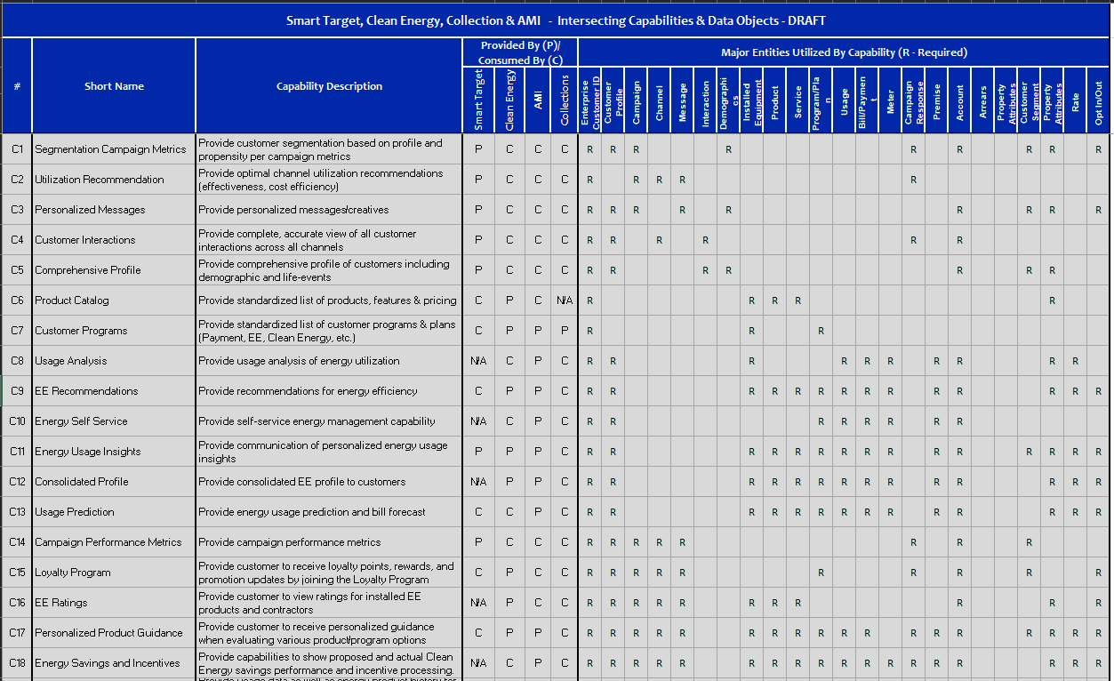
US Customer Capabilities by Programs

Slide 4

US Customer Business Capabilities Proposed Roadmap (Draft)
Delivery / Value Streams:
Data Management Foundational
Customer Data Foundational
Customer Data Integration Services
2021
2022
Releases:
Jul
Aug
Sep
Oct
Nov
Dec
Jan
Feb
Mar
April
May
Jun
Jul
Aug
Sep
Oct
Nov
Dec
MVP R1
MVP R2
MVP R3
MVP R4
MVP R5
Business Capabilities Support
Informatica Catalog, Governance and Quality Tools available
C7 – Product Catalog
C8 – Customer Programs
C1 – Segmentation Campaign Metrics
C3 – Personalized
Messages
C13 – Consolidated Profile (Partial)
C8 – Customer Programs
C2 – Utilization Recommendation
C4 – Customer
Interactions
Reltio MDM and Matillion Tools available (US)
First Call Resolution
C14 – Usage Prediction
C5 – Comprehensive Profile
C10 – EE Recommendations
C8 – Customer Programs
C15 –Campaign
Performance Metrics
C11 – Energy Self Service
C12 – Energy Usage Insights
C17 – EE Ratings
C18 – Personalized Product Guidance
C16 – Loyalty
Program
C20 – Usage History
C19 – Energy Savings and Incentives
C22 – Proactive Usage Feedback
C21 – Enrollment Offers
C9 – Usage Analysis
C23 – Outage Status
C25 – Customer Balance
Near real time Replicate
MDM/DQ/DG
Customer Data model, Data Catalog, Data Governance, Data Quality Profiling, CDC, Business Rules/Requirement
Persistent ID (leverage UDM) , Key Customer Profile and contact fields, Billing Account
Customer Demographic,
Preference, Premise, Service Account, Meter
Customer, Segments,
Customer Programs/Plans
ECDP (Snowflake)
Data Quality Profiling, CDC, Business Rules/Requirement
Persistent ID (leverage UDM) , Key Customer Profile and contact fields, Service Account
Agent, Workforce, Call Detail
Usage, Bill/Credit/Payment, Customer Demographic,
Preference, Premise, Billing Account, Meter
Customer Segments,
Customer Program/Plan, Campaign, Campaign Response, IVR
Customer Interaction,
Messages, Addition Customer Data
Notes:
Bottom-up view of enabling Data Capabilities in support of prioritized business capabilities
- Iterative approach to building out capabilities incrementally though data enablement – Clean data available and under management - Master Data managed under MDM and both Master and Transaction Data Available within the Data Hub
Business Capabilities sequencing and timelines are still subject to Top-Down Analysis under the Program Governance & Alignment and Technology Solutioning Towers (taking place over the next 3-4 months, but subject to funding)
- Programs need to re-align priorities and release plan, cross-program gaps and dependencies need to be revisited and programs must be funded and resourced accordingly. This is especially impacted by program gaps in CRM and Automated
Marketing capabilities
- Note: CRM and Marketing Automation Completes in Dec 2022
Timelines for many of the required business capabilities extend beyond May-2022 which are being driving by process and tech changes
Some Capabilities that the Blueprint suggests will be dependent on a step change in platform can begin to be enabled by a Step change in data (e.g. Billing Insights). Other such as (New Service Connect) will obviously be clearly be dependent on AMI service

Slide 5
US Customer Business Capabilities Proposed Roadmap (2022)
Delivery / Value Streams:
Data Management Foundational
Customer Data Foundational
Customer Data Integration Services
2022
2023
Jan
Feb
Mar
April
May
Jun
Jul
Aug
Sep
Oct
Nov
Dec
Jan
Feb
Mar
April
ECDP (Curated Snowflake)
Business Capabilities Support
C7 – Product Catalog
First Call Resolution 1.0
Near real time Replicate (CSS/CRIS)
C3 – Personalized
Messages
C13 – Consolidated Profile (Partial)
C4 – Customer
Interactions
Reltio MDM and Matillion Tools available (US)
First Call Resolution 2.0
C15 –Campaign
Performance Metrics
C16 – Loyalty
Program
MDM/DQ/DG
Persistent ID (leverage UDM) , Key Customer Profile and contact fields, Billing Account
Additional MDM Attributes, Near real-time data load
Customer, Segments,
Customer Programs/Plans
Meter. Meter Reference Data
ECDP (Raw Snowflake)
Weekly
CRIS, CSS data
Persistent ID (leverage UDM) , Key Customer Profile and contact fields, Billing Account
Agent, Workforce, Call Detail
Real near-time
CRIS, CSS data
FCR Dashboard
ECDP (Curated Snowflake)
Persistent ID , Key Customer Profile and contact fields, Billing Account
Billing, Customer Segment. Web Profile. Preference, Rate Location
Payments, Credits Programs/Apps, Measurements, Vendors, Agents
Notes:
Bottom-up view of enabling Data Capabilities in support of prioritized business capabilities
- Iterative approach to building out capabilities incrementally though data enablement – Clean data available and under management - Master Data managed under MDM and both Master and Transaction Data Available within the Data Hub
Business Capabilities sequencing and timelines are still subject to Top-Down Analysis under the Program Governance & Alignment and Technology Solutioning Towers (taking place over the next 3-4 months, but subject to funding)
- Programs need to re-align priorities and release plan, cross-program gaps and dependencies need to be revisited and programs must be funded and resourced accordingly. This is especially impacted by program gaps in CRM and Automated
Marketing capabilities
- Note: CRM and Marketing Automation Completes in Dec 2022
Timelines for many of the required business capabilities extend beyond May-2022 which are being driving by process and tech changes
Some Capabilities that the Blueprint suggests will be dependent on a step change in platform can begin to be enabled by a Step change in data (e.g. Billing Insights). Other such as (New Service Connect) will obviously be clearly be dependent on AMI service

Slide 6
Business Entities
Customer
Customer Profile
Location

Slide 7
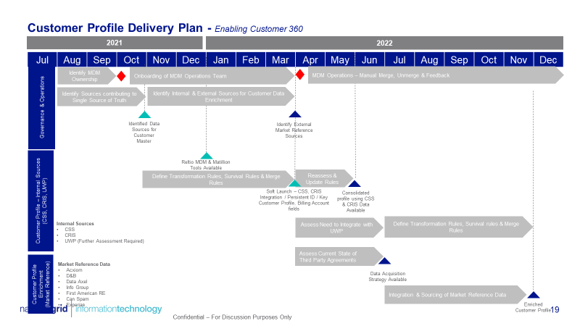
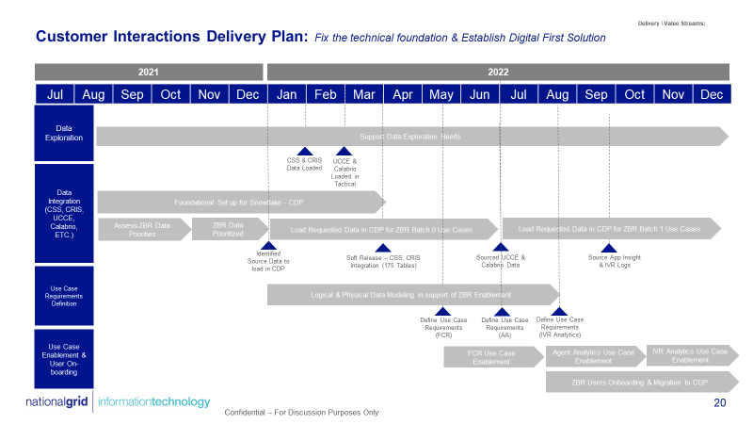
CDP Product teams – 2022 Road Map
Customer Profile
Customer Interactions

